Slide 1
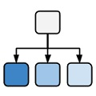
Ontologies
in computational biology
Michel Dumontier, Ph.D.
Distinguished Professor of Data Science
Director, Institute of Data Science
Maastricht University
1
ISMB 2018 Ontologies Tutorial in Chicago
Notes:
1

Slide 2
Outline
What are ontologies?
Why are they important?
Reasoning with ontologies
Applications in biomedicine
2

Slide 3
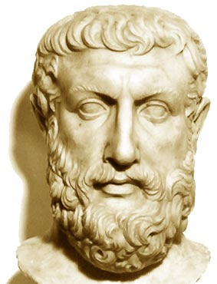
What is an ontology?
Ontology stands for a logical discourse of existence. It aims to uncover and describe the nature and structure of existence.
Predominantly the domain of philosophy known as metaphysics
Address questions such as
What does it mean to be?
What constitutes the identity of an object?
What categories of things exist?
Ontologies, when communicated to others, foster a shared understanding of things.
Greek philosopher Parmenides (515BC) proposed an ontological characterization of the fundamental nature of reality – akin to a grand unification theory
3

Slide 4
Why are ontologies important?
To foster a shared understanding of entities, their attributes, and the relationships they hold
To develop a computer-accessible descriptions of the entities and their relationships
To enable discovery, exchange, and reuse of data and knowledge

Slide 5
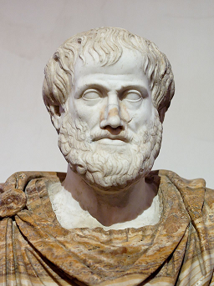
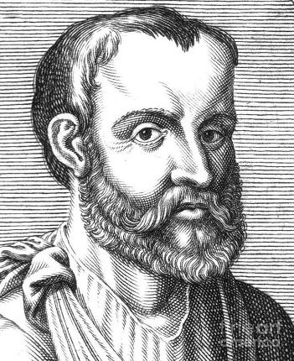
Early Ontologists
Aristotle (384-322 BC)
First systematic taxonomy of biology
Classification of organisms by shared properties
Used binomial genus-differentia nomenclature
Galen (130-210 AD)
Systematic description of diseases, signs and symptoms.
In De Febrium Differentia description of fever symptoms he uses the Aristotelian genus-differentia approach
5

Slide 6
genus–differentia definitions
are one way to specify ontologies
A type of intensional definition - where necessary and sufficient conditions are specified - composed of two parts:
genus: Serves as the basis for a new definition; all definitions with the same genus are considered members of that genus.
differentia: The portion of the definition that is not provided by the genus.
a rhombus: a quadrilateral that has bounding sides which all have the same length.
a square: a rhombus that has interior angles which are all right angles.
6

Slide 7
Porphyry’s depiction of
Aristotle’s Categories
Supreme genus: SUBSTANCE
Differentiae: material immaterial
Subordinate genera BODY SPIRIT
Differentiae: animate inanimate
Subordinate genera: LIVING MINERAL
Differentiae: sensitive insensitive
Proximate genera: ANIMAL PLANT
Differentiae: rational irrational
Species: HUMAN BEAST
Individuals: Socrates Plato Aristotle …
7

Slide 8
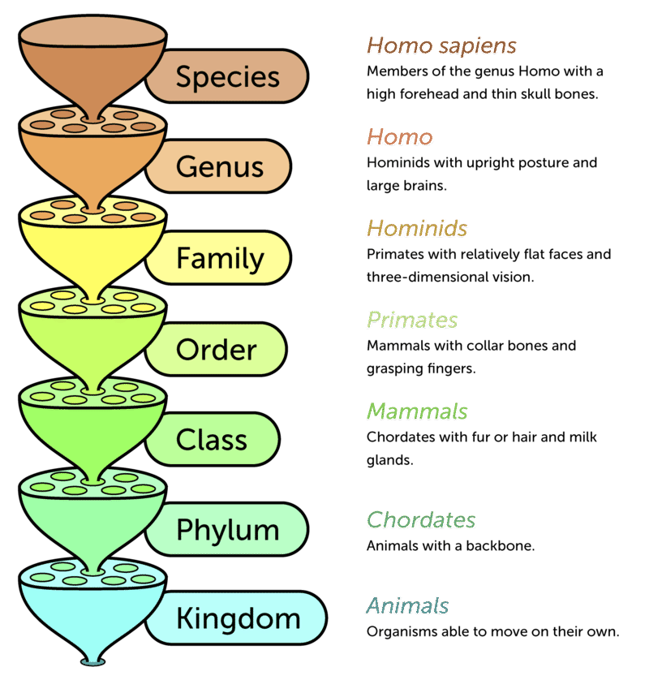
Biological Taxonomy
A biological classification (taxonomy) by Carl Linnaeus in his Systema Naturae (1735)
Three kingdoms, divided into classes, and they, in turn, into orders, families, genera, and species, with an additional rank lower than species.
Rank: a classification
Of taxonomic categories
Biological taxonomy:
an is-a hierarchy
of biological types
8

Slide 9
Genus-differentia illustrates basic inference vis-à-vis the “is a” relationship
Mammal
Is a
Chordate
Is a
Mammal
Is a
Animal
Chordate
Animal
9

Slide 10
Development of an increasingly
applied notion of ontology
An explicit specification of a conceptualization
- Thomas Robert Gruber, 1993 (inventor of Siri)
A conceptualization is the way we think about a domain (a “system of categories accounting for a particular view on the world”, i.e., a philosophical ontology)
A specification provides a formal way of writing it down (and making it accessible to humans and machines)
A formal speciﬁcation of a shared conceptualization
- Borst 1997
An ontology specifies a vocabulary with which to make assertions, which may be inputs or outputs of knowledge agents (such as a software program). … an ontology must be formulated in some representation language
- Gruber (2007)
An ontology is defined by axioms in a formal language with the goal to provide an unbiased (domain- and application-independent) view on reality
10

Slide 11
How is an ontology different than a…
Folksonomy
A collection of terms (tags) to enhance categorization.
Glossary
List of terms with definitions and explanations in natural language
Controlled Vocabulary
An enumeration of terms defined to be shared and reused.
Hierarchy
A nested set of terms
Taxonomy
A hierarchy that uses the “is a” relation.
Meronomy
A hierarchy that uses the “part of” relation.
Classification
A set of categories in which objects are grouped into a hierarchy
11
Notes:
11

Slide 12
Question
What is true about an ontology or a classification?
A classification focuses on grouping together relevant terms
A classification does not require a formal representation of the classes
An ontology is a formal representation that aims to accurately describe entities, their attributes, and their relationships
All of the above

Slide 13
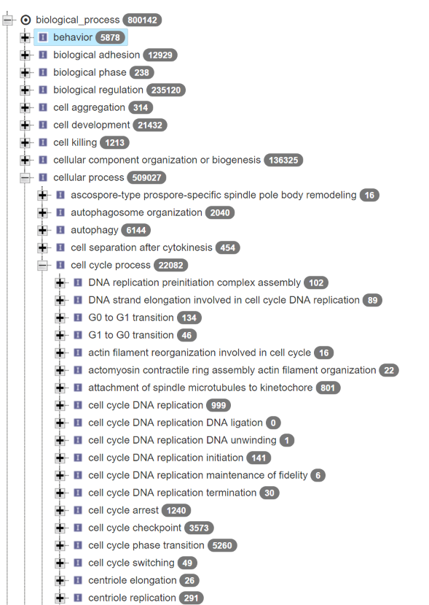

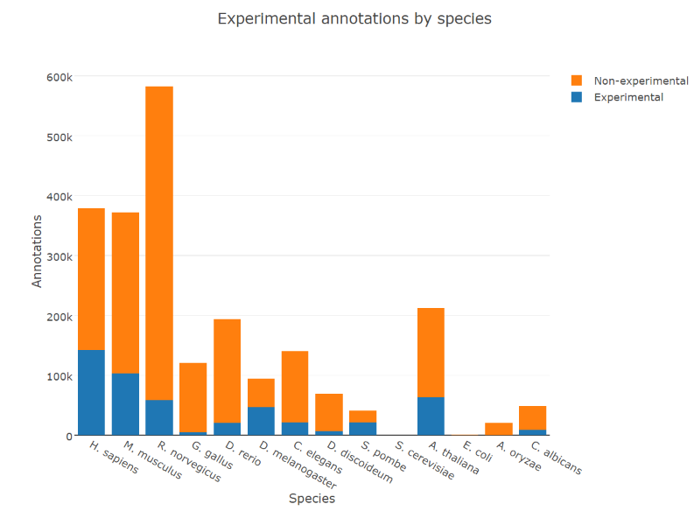
Gene Ontology
Arguably one of the most successful ontology projects in the life sciences.
Millions of annotations on hundreds of thousands of genes using tens of thousands of GO terms.
The GO defines types used to describe gene function. It classifies functions along three aspects:
cellular component
where gene products operate
molecular function
what gene products do
biological process
The pathways and processes that gene products participate in
13

Slide 14
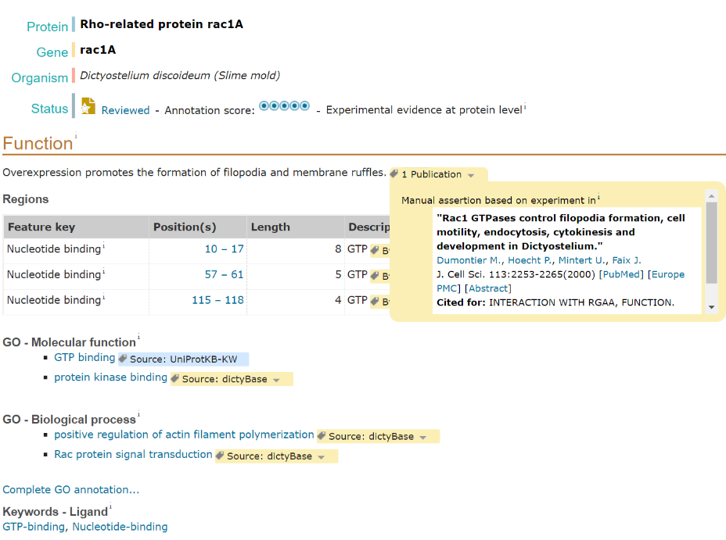
14

Slide 15
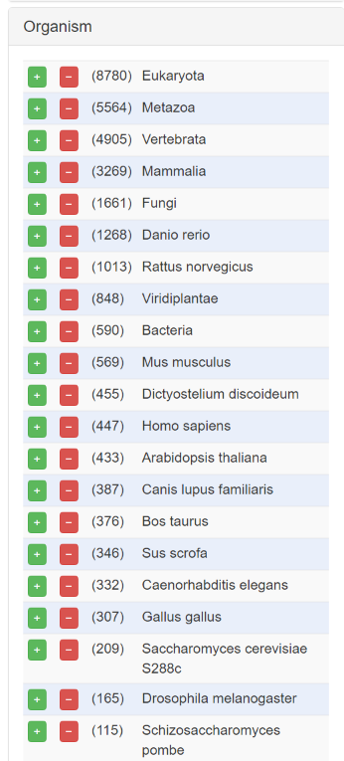
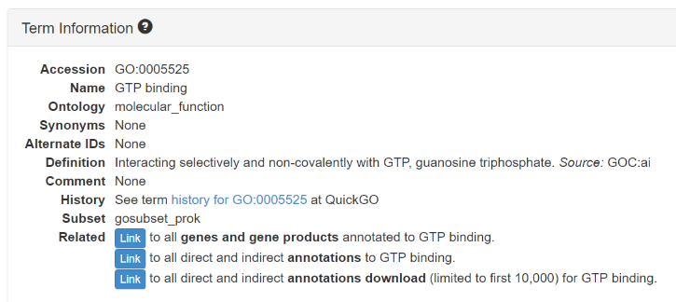
GO enables interoperability of descriptions across species
15

Slide 16
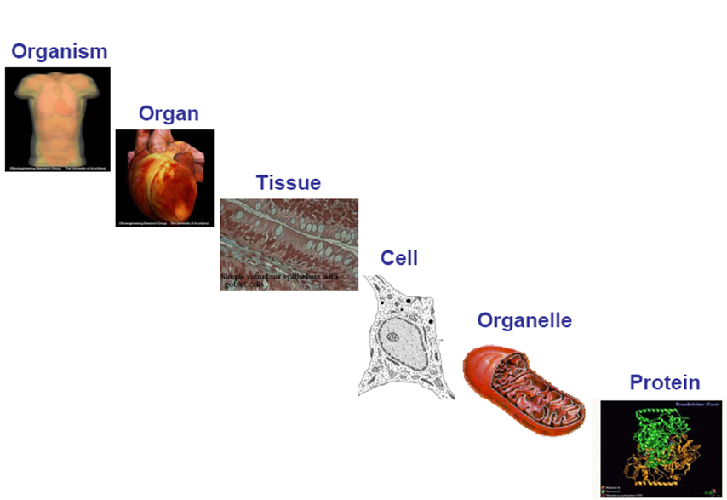
Ontologies across scales
16
Notes:
16

Slide 17
some disease and phenotype ontologies
Disease Ontology (DO)
standardized ontology for human disease
Mapped to major terminologies, UMLS, MeSH, ICD10 etc.
11,280 classes
Human Phenotype Ontology ( HPO )
phenotypic features encountered in human hereditary and other disease
15,381 classes
Mammalian Phenotype Ontology (MP)
Phenotypic features encountered in animal models
12,805 classes
SNOMED-CT
clinical terminology, diseases, diagnostics and procedures
324,129 classes
Unified Medical Language System (UMLS)
US National Library of Medicine
terminology, classification and coding standards
8M normalized concepts
NCI thesaurus
vocabulary for clinical care, translational and basic research, and public information and administrative activities.
118,941 classes
LOINC
labs, vitals signs, clinical documents
187,123 classes
ICD-10
disease, epidemiology, billing
12,450 classes
17
Notes:
17

Slide 18



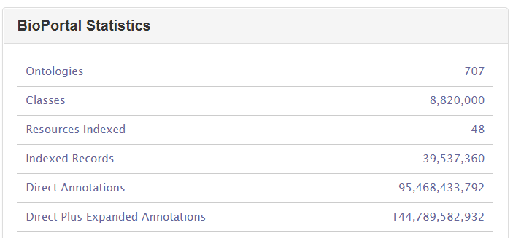
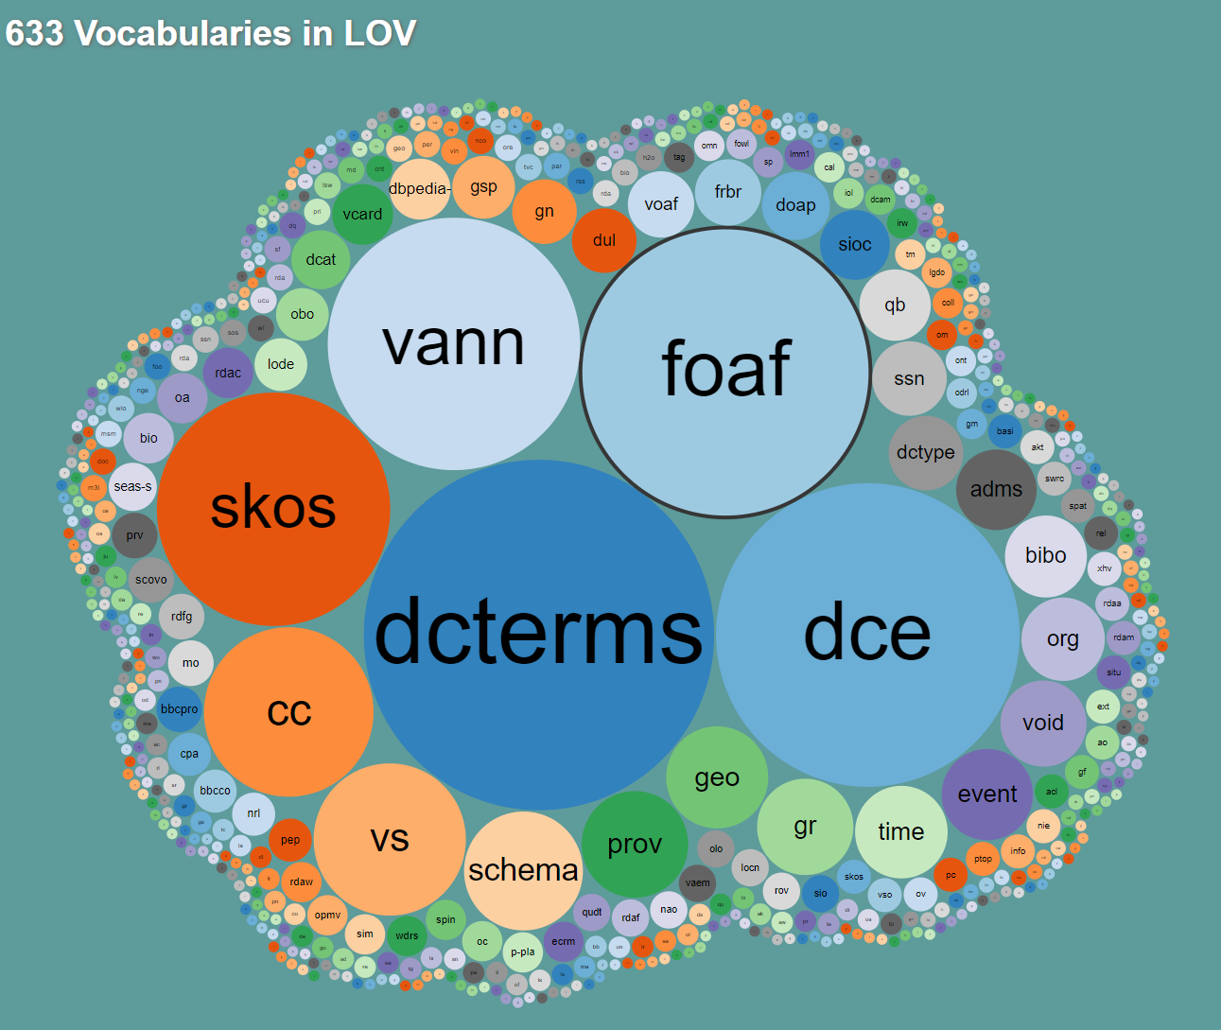
Where can we get ontologies?
18

Slide 19
Formalization
Formalization is the process by which we map a conceptualization into a logical representation.
We logically combine the terms to form expressions, which have an unambiguous interpretation, and hence can be automatically reasoned about to answer questions.
19

Slide 20
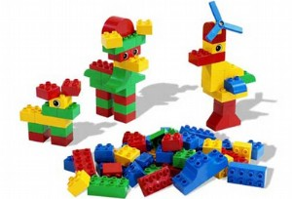
Logic-Based Ontologies Can Be constructed From Concept and relation Lego
20
Notes:
20

Slide 21
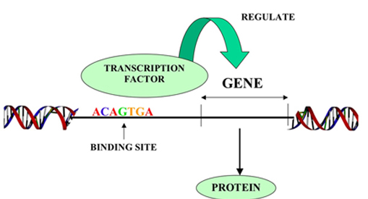
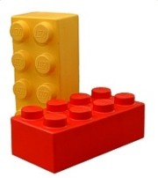
Description logics offer the building blocks
for constructing computable ontologies
A transcription factor is a protein that binds to DNA and regulates the rate of transcription
molecule ontology
‘transcription factor’
equivalentTo
‘protein’
that ‘binds to’ some DNA
and ‘regulates’ some ‘rate of transcription’
relation ontology
function ontology
21
Notes:
21

Slide 22


Have you heard of OWL?
22
Notes:
Slick used car salesman
22

Slide 23
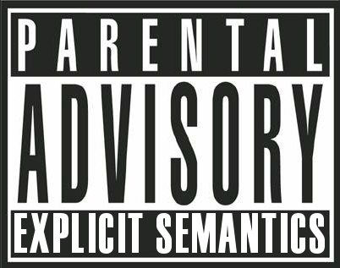
The Web Ontology Language (OWL) Has Explicit Semantics
It can be used to capture knowledge in a machine understandable way
23
Notes:
23

Slide 24
OWL provides an extensive vocabulary to more precisely represent knowledge
Conjunction (and)
Disjunction (or)
Negation (not)
Disjointness (sameAs, differentFrom)
Quantification (some, only, 0->n)
existential, universal, cardinality restriction
property characteristics
transitive, functional, inverse functional, symmetric, antisymmetric, reflexive, irreflexive
complex classes expressions in domain and range restrictions
property chains

Slide 25
What is a class?
A class represents a group of individuals that share one or more things in common.
e.g. The class of “transcription factor” represents all entities that satisfy the criteria for class membership.
25

Slide 26
What is an instance?
An instance is an individual that is a member of a class.
e.g. An individual transcription molecule in the cell is an instance of the class “transcription factor”
e.g. Michel is an instance of Person
An individual can be a member of more than one class. For instance a transcription factor is also a member of the class Protein.
26

Slide 27
An individual may have properties
These properties can refer to attributes of the individual or relations to other individuals.
That individual transcription factor is bound to a single molecule of DNA
Robert is a colleague of Michel
27

Slide 28
subClass
A subClass is a class that minimally exhibits all the attributes of a parent class, and potentially more.
Transcription Factor subClassOf Protein
all transcription factors are also proteins -> each transcription factor shares all the attributes that proteins do.
However, the inverse, that all proteins are transcription factors is not implied.
28

Slide 29
Equivalent class
Two classes are equivalent when they are intensionally the same, and must therefore contain exactly the same individuals.
For example, we often use the term Protein and Polypeptide interchangeably, meaning that every instance of the class Protein is also an instance of class Polypeptide, and vice versa.
29

Slide 30
Disjoint classes
Two classes are disjoint when they cannot share the same instances. Membership in one class precludes membership in the other.
For example, no molecule can both be wholly a DNA molecule and also be a Protein molecule.
owl:disjointClasses ( DNA, Protein )
30

Slide 31
Same and different individuals
OWL does not assume that two names imply two different individuals (Open World Assumption).
In fact, one individual may have two names – e.g. P38398 and Q7KYU9 are two names for BRCA1 - so it would be wrong to assume/conclude that these refer to two different individuals (Closed World Assumption)
However, OWL provides a mechanism to explicitly indicate that individuals are the same as (owl:sameAs) or different from (owl:differentFrom) one another.
31

Slide 32
Same and different individuals
This has important implications when counting the number of entities in a knowledge base.
Individual: P38398
Individual: Q7KYU9
Individual: Q16512
-> how many individuals are there? At least 1
P38398 owl:sameAs Q7KYU9
-> how many individuals are there? At least 1
P38398 owl:differentFrom Q16512
-> how many individuals are there? At least 2
32

Slide 33
More complex class expressions
We can define more complex descriptions of a class by combining classes and properties together. The basic constructors are ‘and’/’that’, ‘or’, ‘not’, ‘some’, ‘only’, ‘min’, ‘max’.
‘transcription factor’
equivalentTo
‘protein’
that ‘binds to’ some DNA
and ‘regulates’ min 1 ‘rate of transcription’
33

Slide 34
Domain/Range Entailments
We can set the domain and range of a relation in order to infer class membership for individuals involved in those relations
Michel hasColleague Robert
hasColleague:
Domain: Person ; Range: Person
-> Michel instanceOf Person
-> Robert instanceOf Person
34

Slide 35
Universal Quantification
Axioms involving universal quantification also generate an entailment for the object in a relation
Person subClassOf hasColleague only Person
Michel hasColleague Robert
-> Robert instanceOf Person
35

Slide 36
Reasoning over OWL ontologies
Consistency: determines whether the ontology contains contradictions.
(1) DNA disjointFrom Protein (2) myprotein instanceOf protein (3) myprotein instanceOf DNA
Satisfiability: determines whether classes can have instances.
(1) DNA disjointFrom Protein (2) DNA subClassOf Protein
Subsumption: are all instances of one class also instances of another class?
(1) Protein subClassOf Molecule
Classification: repetitive application of subsumption to discover implicit subclass links between named classes
(1) Transcription Factor equivalentTo Protein …
-> (2) Transcription Factor subClassOf Protein
Realization: find the most specific class that an individual belongs to.
36

Slide 37

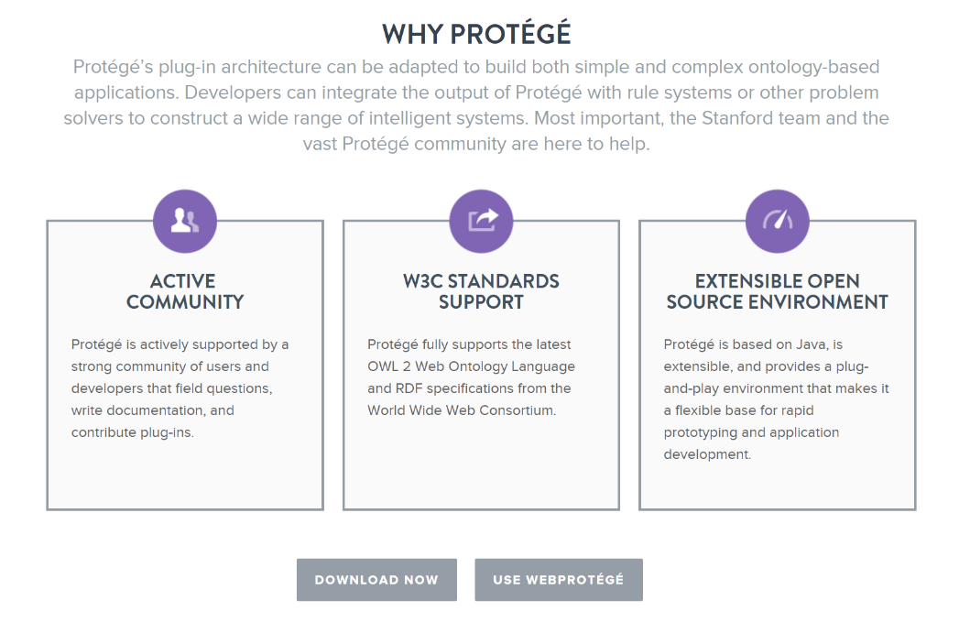

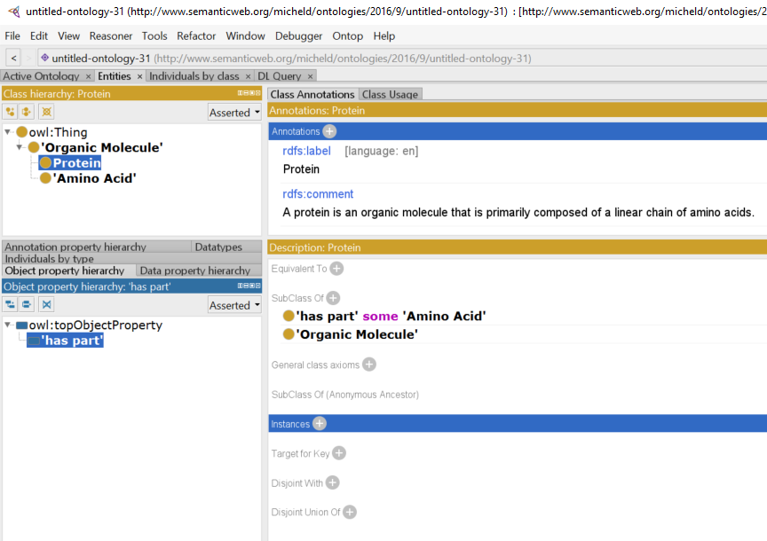
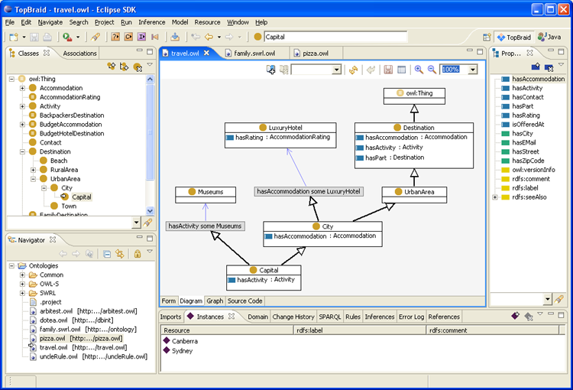
37

Slide 38
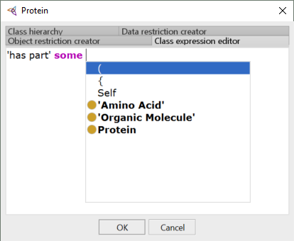
differentia
genus
38

Slide 39
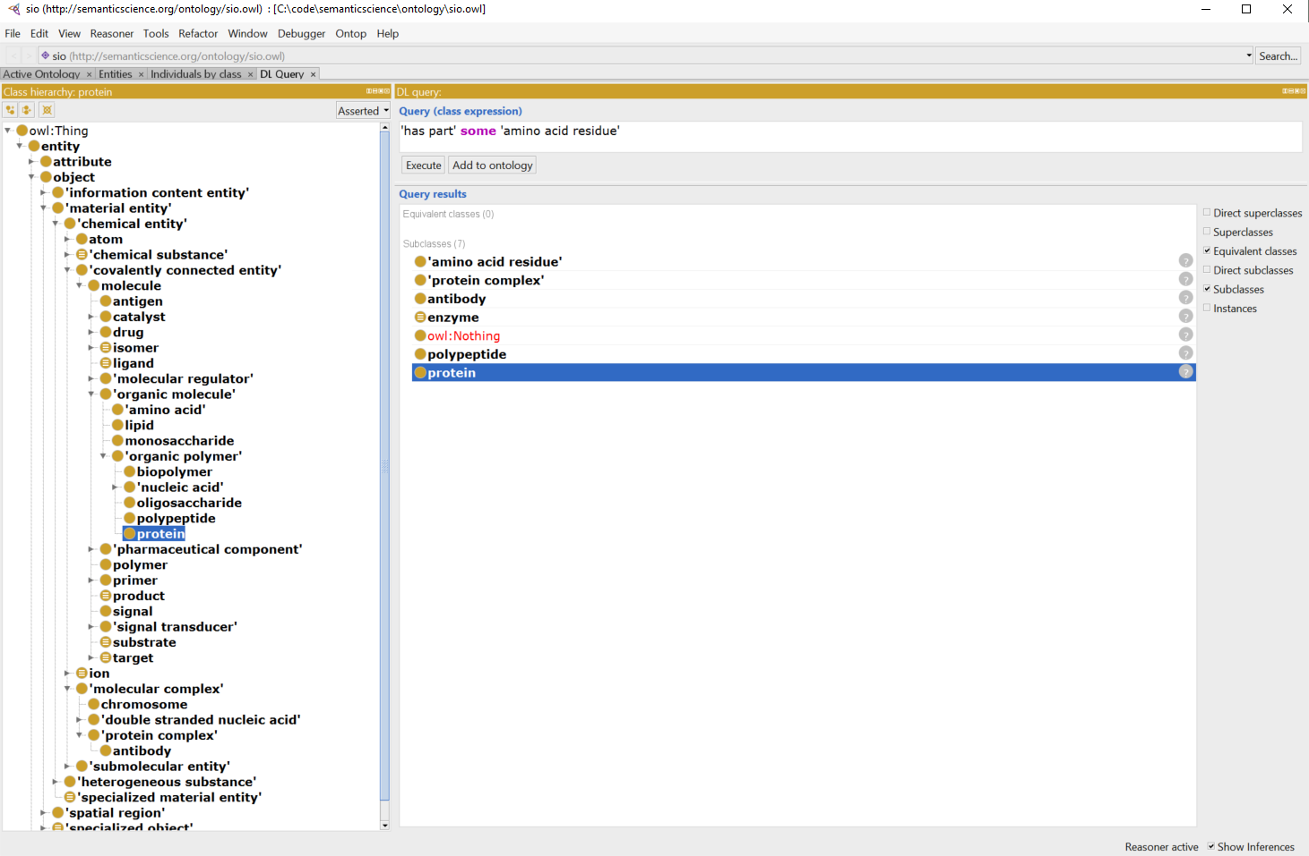
Query answering
39

Slide 40
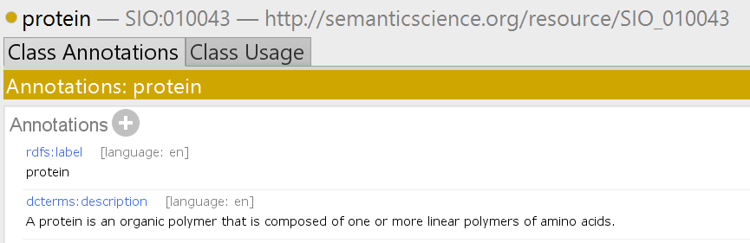
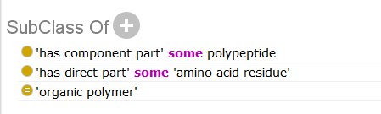
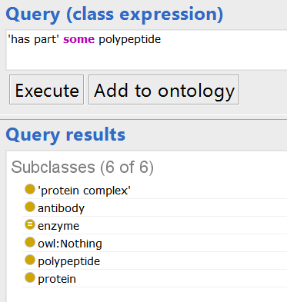
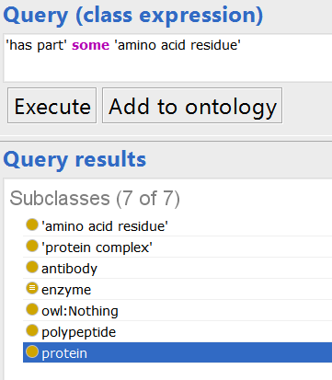

Slide 41
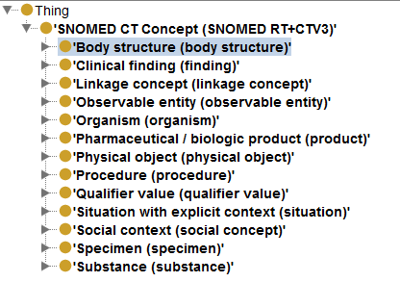
SNOMED-CT
SNOMED-CT (Clinical Terms) ontology
used in healthcare systems of more than 15 countries, including Australia, Canada, Denmark, Spain, Sweden and the UK
used by major US providers
ontology provides common vocabulary for recording clinical data
324,129 classes
41

Slide 42
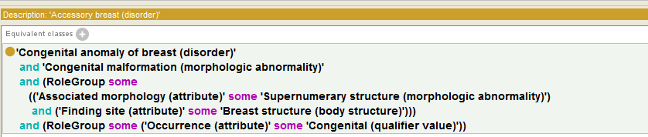
SNOMED-CT
Pattern based knowledge capture
Requires some training and an information system to implement
42

Slide 43
SNOMED - Verification
Kaiser Permanente extended SNOMED to express, e.g.:
non-viral pneumonia (negation)
infectious pneumonia is caused by a virus or a bacterium (disjunction)
double pneumonia occurs in two lungs (cardinalities)
This is easy in SNOMED-OWL
but reasoner failed to find expected subsumptions, e.g., that bacterial pneumonia is a kind of non-viral pneumonia
Ontology under-constrained: need to add disjointness axioms
virus and bacterium must be disjoint
Adding disjointness led to surprising results
many classes become inconsistent, e.g., percutanious embolization of hepatic artery using fluoroscopy guidance
Cause of inconsistencies identified in the class groin
groin asserted to be subclass of both abdomen and leg
abdomen and leg are disjoint
modelling of groin (and other similar “junction” regions) identified as incorrect
43

Slide 44
Reasoning with Ontologies
hasPet some owl:Thing subClassOf Human
Phoenix subClassOf petOf only Wizard
HarryPotter instanceOf Wizard
DracoMalfoy instanceOf Wizard
HarryPotter hasFriend RonWeasly
HarryPotter hasFriend HermioneGranger
HarryPotter hasPet Hedwig
Is DracoMalfoy a friend of HarryPotter?
44

Slide 45
Reasoning with Ontologies
hasPet some owl:Thing subClassOf :Human
Phoenix subClassOf: petOf only Wizard
HarryPotter instanceOf Wizard
DracoMalfoy instanceOf Wizard
HarryPotter hasFriend RonWeasly
HarryPotter hasFriend HermioneGranger
HarryPotter hasPet Hedwig
Is Draco a friend of Harry Potter?
-> we do not know. No -> DB closed reasoning
45

Slide 46
Reasoning with Ontologies
hasPet some owl:Thing subClassOf Human
Phoenix subClassOf petOf only Wizard
isPetOf inverseOf hasPet
facts:
Fawkes instanceOf Phoenix
Fawkes isPetOf DumbleDore
What new facts do we entail?
46

Slide 47
Reasoning with Ontologies
Fawkes isPetOf DumbleDore
isPetOf inverseOf hasPet
-> DumbleDore hasPet Fawkes
hasPet some owl:Thing subClassOf Human
-> DumbleDore instanceOf Human
Fawkes instanceOf Phoenix
Phoenix subClassOf petOf only Wizard
-> Dumbledore instanceOf Wizard
47

Slide 48
Applications in Biomedicine

Slide 49
Use of ontologies for the diagnosis of rare diseases

Slide 50
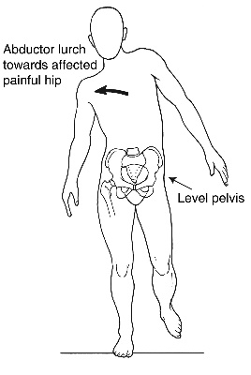
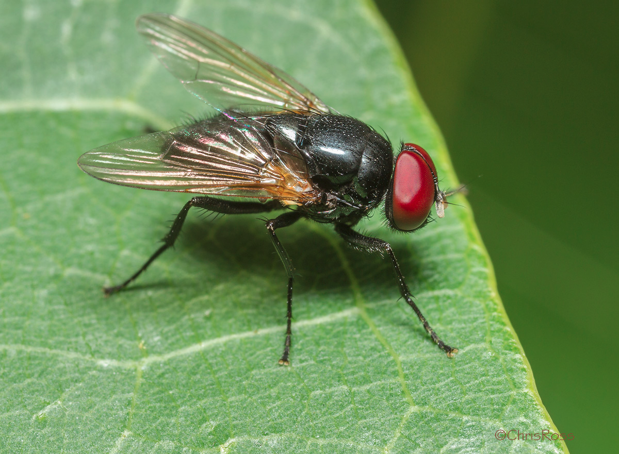
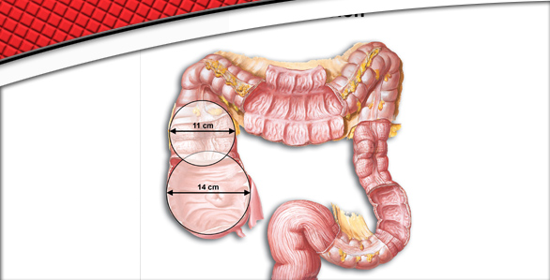
Phenotypes
A phenotype is an observable characteristic of an individual and typically pertains to its morphology, function, and behavior.
qualitative, normal and abnormal phenoytpes
red eye color, abnormal gait, enlarged colon

Slide 51
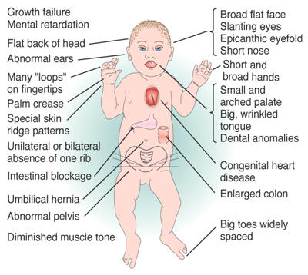
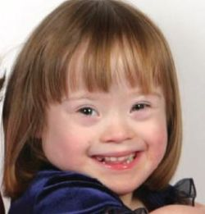
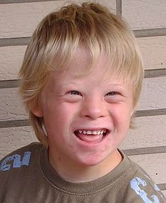

Diagnosis uses observable/measured phenotypes
“Phenotypic Profile”
Notes:
Together, the set of phenotypes constitute a “phenotypic profile”

Slide 52
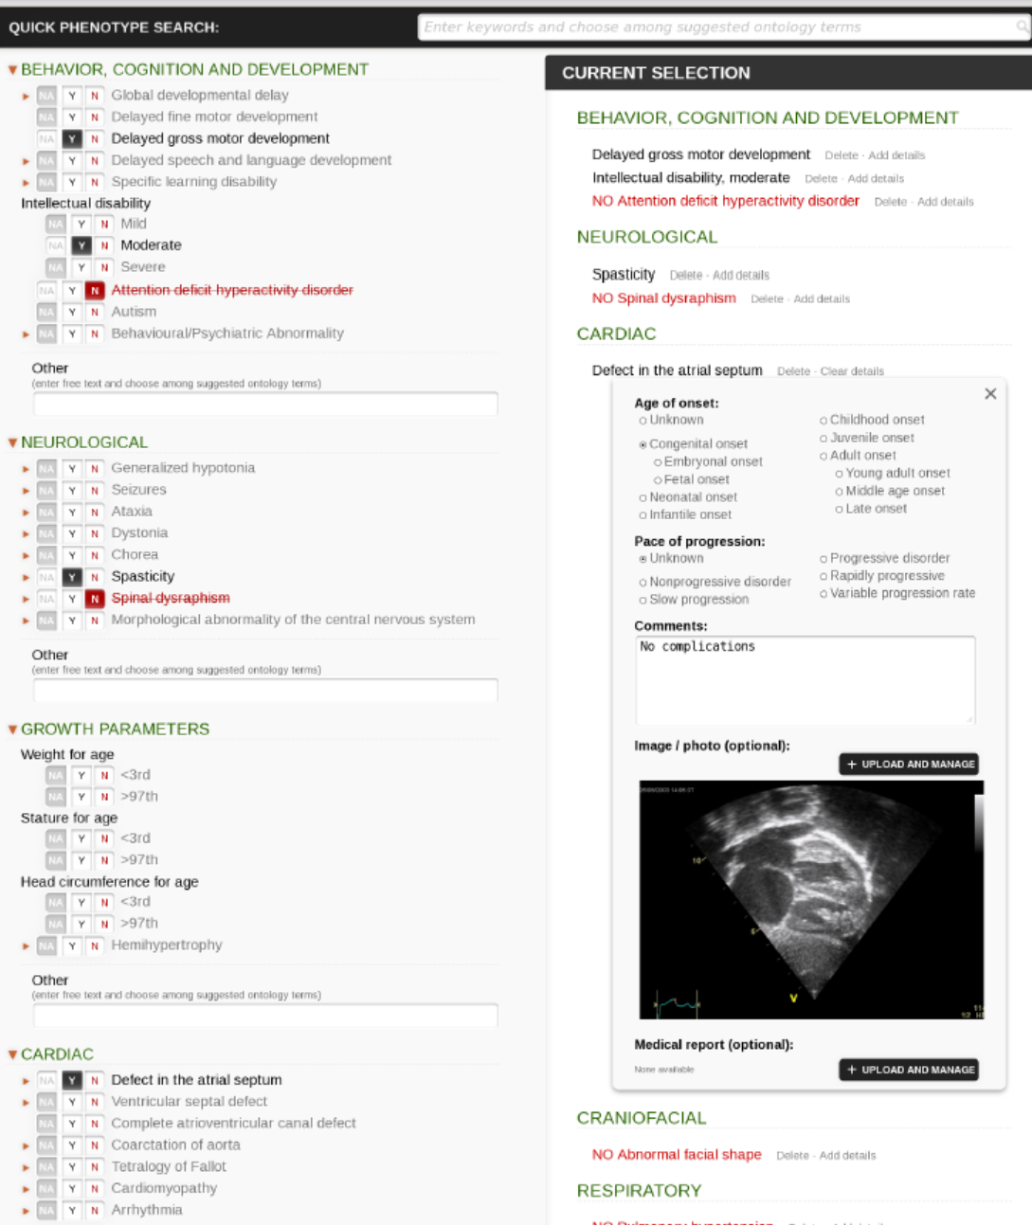
Phenotips
Using controlled vocabulary (human phenotype ontology) for phenotyping
Can collect demographics, medical history, family history, labs, findings
Girdea et al. (2013). Hum. Mutat., 34: 1057–1065. doi: 10.1002/humu.22347
52

Slide 53
Matching patients to diseases
Patient
Flat back of head
Hypotonia
Abnormal skull morphology
Disease X
Decreased muscle mass
Differential diagnosis with similar but non-matching phenotypes is difficult

Slide 54

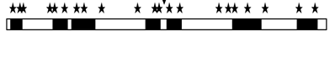
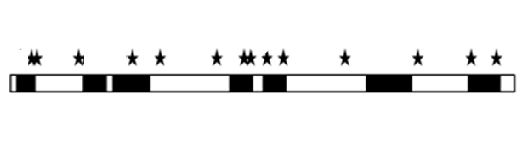

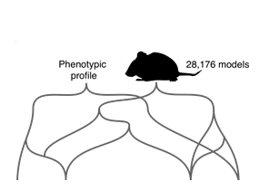

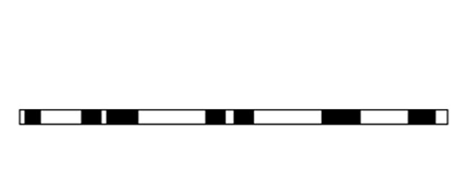
Genotypes + Phenotypes Improves Diagnosis
Target panel of 2741 known
Mendelian disease genes
Remove off-target, common variants, and variants not in known disease causing genes
Compare phenotype profiles from:
Clinvar, OMIM, Orphanet
Credit: Damian Smedley & Will Bone
http://compbio.charite.de/PhenIX/
Zemojtel et al. Sci Transl Med. 2014. 6(252):252ra123

Slide 55
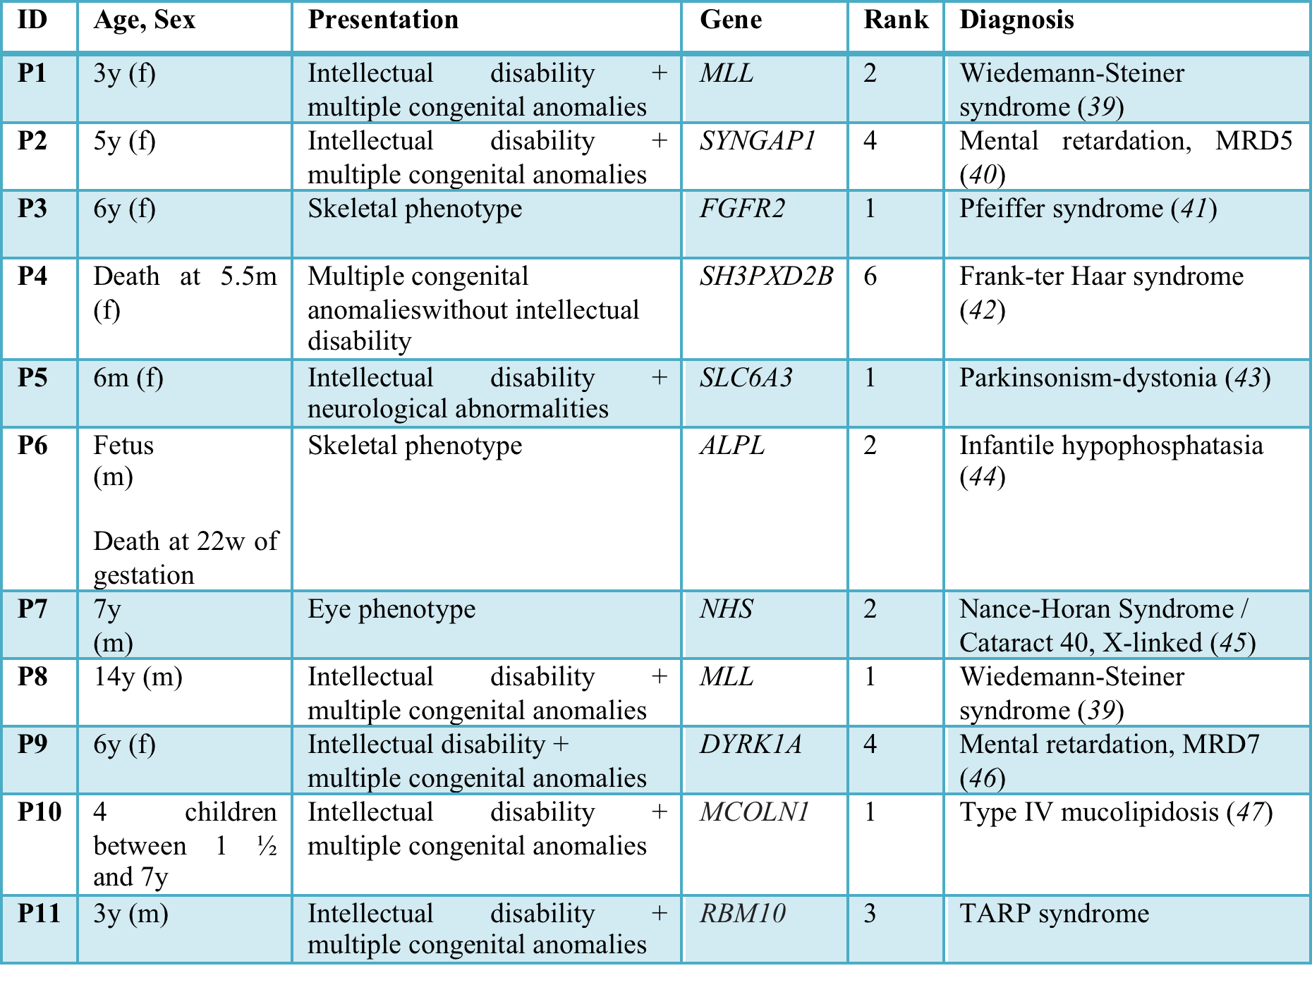
PhenIX helped diagnose 11/40 patients
Notes:
11/40 patients were diagnosed with a known Mendelian disease using PhenIX and a targeted exome panel.

Slide 56
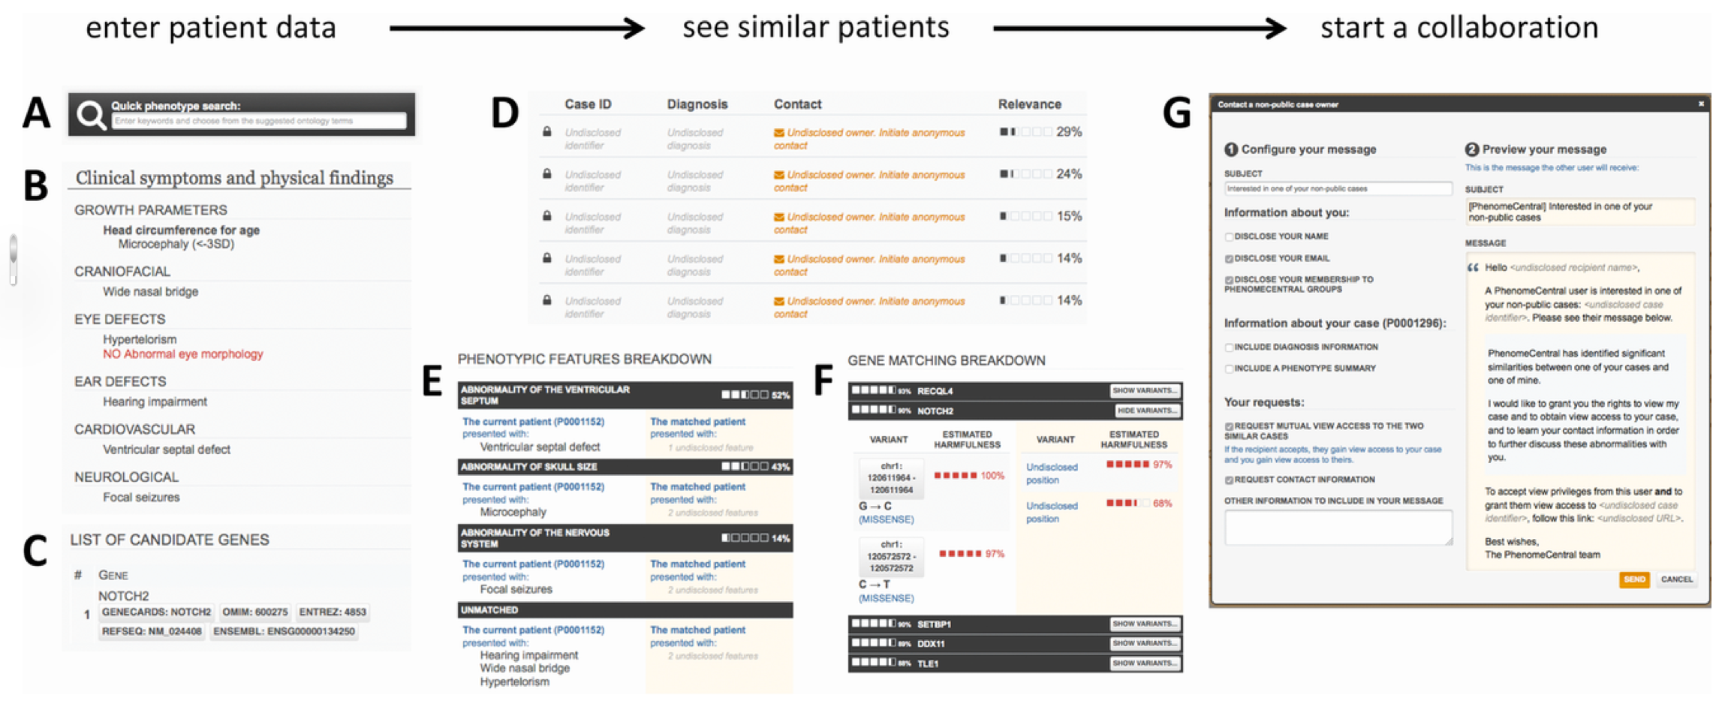
PhenomeCentral: A Portal for Phenotypic and Genotypic Matchmaking of Patients with Rare Genetic Diseases
Human Mutation
Volume 36, Issue 10, pages 931-940, 31 AUG 2015 DOI: 10.1002/humu.22851
http://onlinelibrary.wiley.com/doi/10.1002/humu.22851/full#humu22851-fig-0001
56
Notes:
56
Finding similar patients in PhenomeCentral. Patient data can be contributed to PhenomeCentral through the PhenoTips user interface, including the phenotype quick search box that enables rapid entry of phenotype terms from the HPO (A), or selected records can be automatically deidentified and transferred from any PhenoTips instance automatically. The patient record can contain both present and absent phenotypic features (B) as well as genetic information, including candidate genes and VCF files (C). The patient's features are then immediately compared with all other patients in PhenomeCentral (D), and the best matches are shown to the user. A detailed breakdown of the phenotypic (E) and genotypic (F) similarity is shown for each match, enabling the user to see the underlying reasons for the match and determine whether or not the match is worth following up. A customizable email template (G) facilitates contacting the (potentially undisclosed) submitter of another patient record.
IF THIS IMAGE HAS BEEN PROVIDED BY OR IS OWNED BY A THIRD PARTY, AS INDICATED IN THE CAPTION LINE, THEN FURTHER PERMISSION MAY BE NEEDED BEFORE ANY FURTHER USE. PLEASE CONTACT WILEY'S PERMISSIONS DEPARTMENT ON PERMISSIONS@WILEY.COM OR USE THE RIGHTSLINK SERVICE BY CLICKING ON THE 'REQUEST PERMISSIONS' LINK ACCOMPANYING THIS ARTICLE. WILEY OR AUTHOR OWNED IMAGES MAY BE USED FOR NON-COMMERCIAL PURPOSES, SUBJECT TO PROPER CITATION OF THE ARTICLE, AUTHOR, AND PUBLISHER.

Slide 57
Summary
Ontologies have a rich history in philosophy that has evolved to modular and computable representation of human knowledge
Description logics (e.g. OWL) are the current favored formalism to build and test ontologies.
Ontologies have a variety of uses from the answering questions to enabling sophisticated knowledge discovery.

